Slide 1
Lead Score – Case Study Submitted By: Sidhartha Achary Abhishek Singh

Slide 2
Lead Score – Case Study
Goals of the Case Study There are quite a few goals for this case study. 1.Build a logistic regression model to assign a lead score between 0 and 100 to each of the leads which can be used by the company to target potential leads.
2.There are some more problems presented by the company which your model should be able to adjust to if the company's requirement changes in the future so you will need to handle these as well.

Slide 3
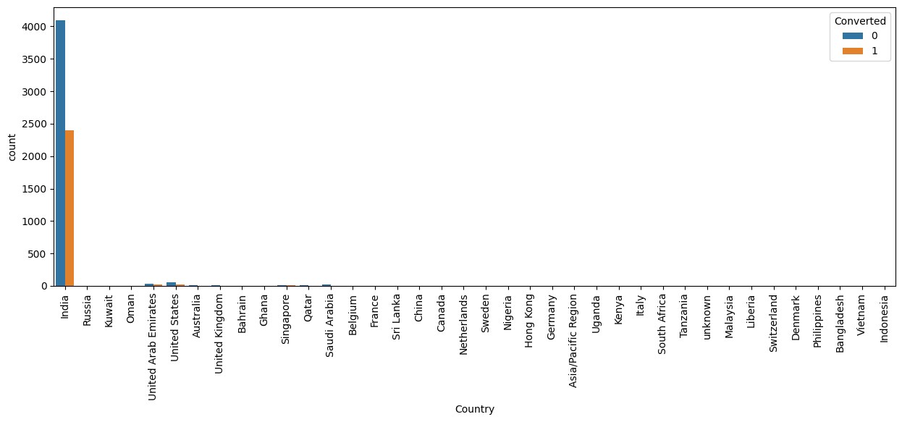
Exploratory Data Analysis
The Number of Values for India are quite high

Slide 4
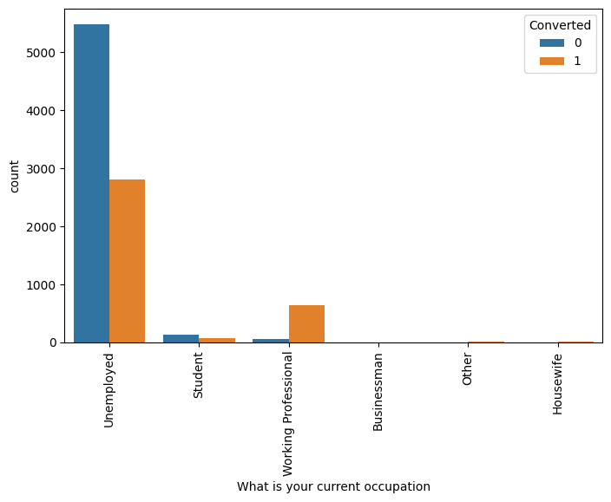
Exploratory Data Analysis
Working Professionals going for the course have high chances of joining it

Slide 5
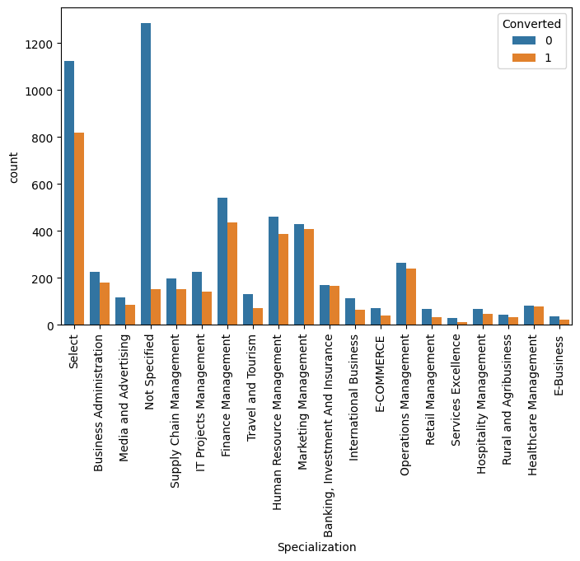
Exploratory Data Analysis
We see that specialization with Management in them have higher number of leads as well as leads converted.

Slide 6
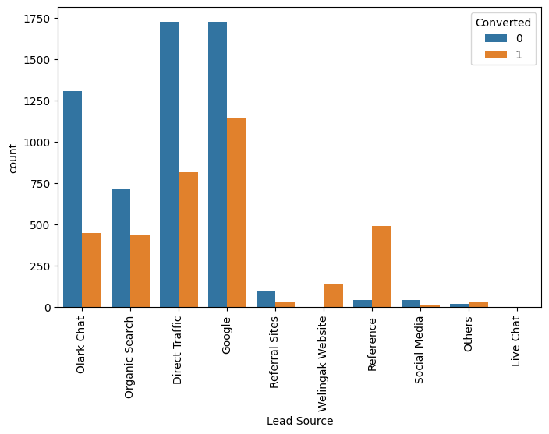
Exploratory Data Analysis
Inference
Maximum number of leads are generated by Google and Direct traffic. Conversion Rate of reference leads and leads through welingak website is high. To improve overall lead conversion rate, focus should be on improving lead converion of olark chat, organic search, direct traffic, and google leads and generate more leads from reference and welingak website

Slide 7
Variables Impacting the Conversion Rate
•Do Not Email
•Total Visits
•Total Time Spent On Website
•Lead Origin – Lead Add Form
•Current Occupation – Working Professional
•Last Notable Activity –Had a Phone Conversation

Slide 8
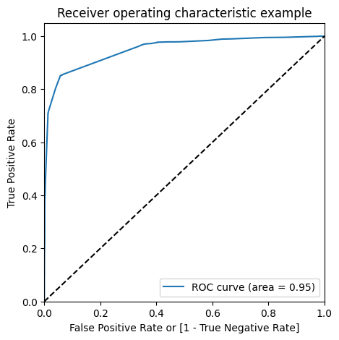
Model Evaluation -Sensitivity and Specificity on Train Data Set
The ROC Curve should be a value close to 1. We are getting a good value of 0.95 indicating a good predictive model.
Finding Optimal Cutoff Point
Above we had chosen an arbitrary cut-off value of 0.5.

Slide 9
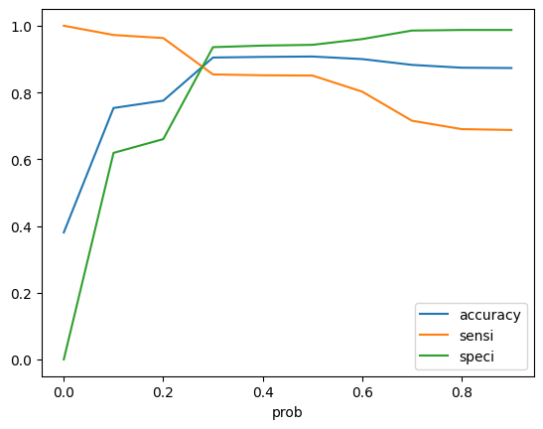
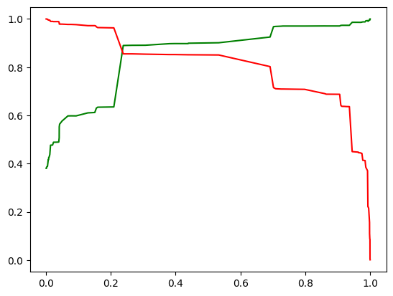
Model Evaluation -Sensitivity and Specificity on Train Data Set
From the curve above, 0.3 is the optimum point to take it as a cutoff probability.

Slide 10
CONCLUSION
While we have checked both Sensitivity-Specificity as well as Precision and Recall Metrics, we have considered the optimal cut off based on Sensitivity and Specificity for calculating the final prediction.
After running the model on the Test Data these are the figures we obtain:
Accuracy : 91.92%
Sensitivity : 85.4%%
Specificity : 93.52%
Train Data:
Accuracy : 90.81%
Sensitivity : 83.2%
Specificity : 92.10%
Test Data:
Accuracy : 91.00%
Sensitivity : 85.0%
Specificity : 90.61%
lead score calculated shows the conversion rate on the final predicted model is around 92.05% (in train set) and 91.41% in test set • The top variables that contribute for lead getting converted in the model are 1. Total time spent on website 2. What is your current occupation 3. Lead Add Form from Lead Origin 4. Had a Phone Conversation from Last Notable Activity

